Slide 1
Here are the winners of
WORK SAFETY COMPETITION

Slide 2
6th place

Slide 3
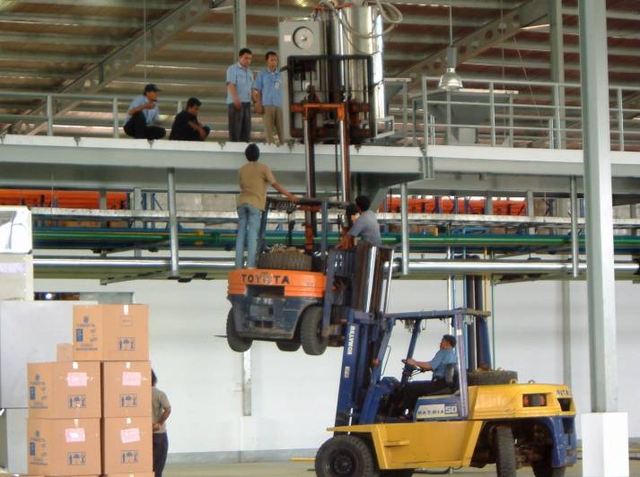

Slide 4
5th place

Slide 5
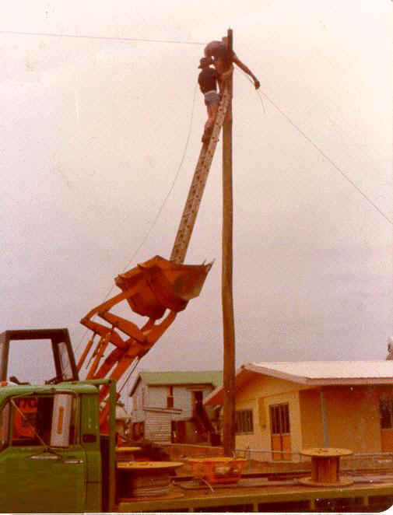

Slide 6
4th place

Slide 7
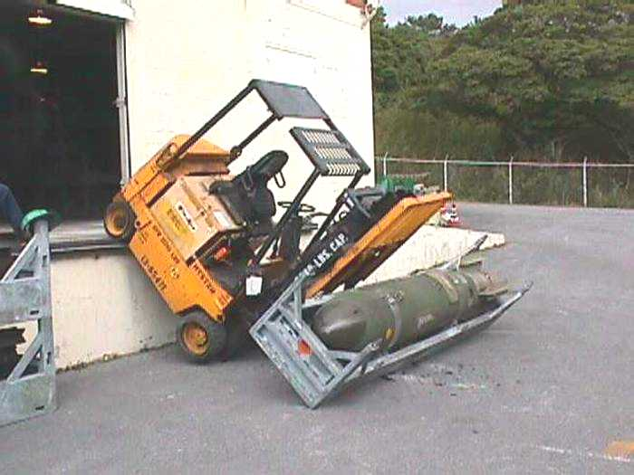

Slide 8
3rd place

Slide 9
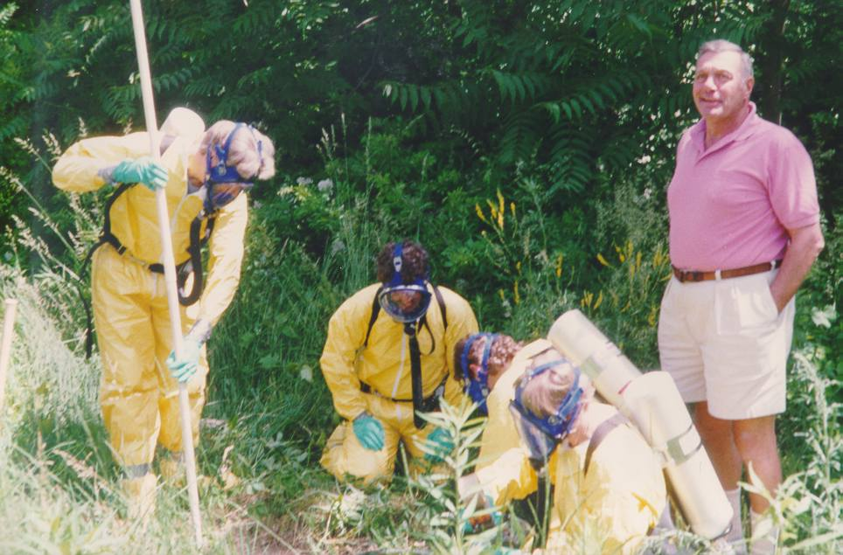

Slide 10
2nd place

Slide 11
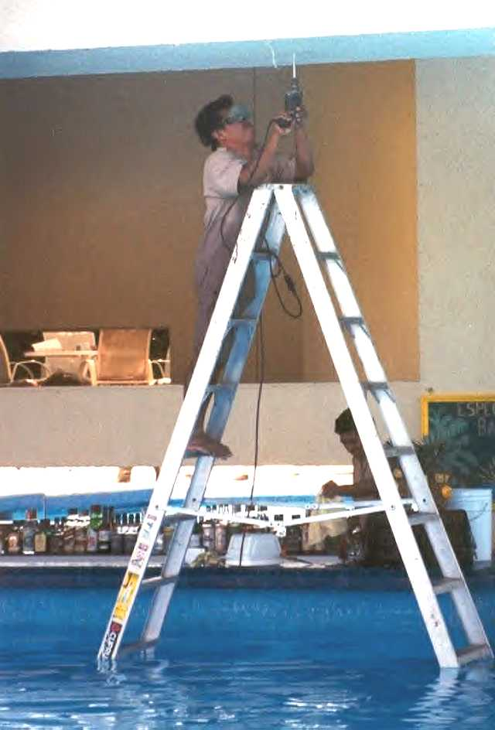

Slide 12
And the WINNER is...

Slide 13
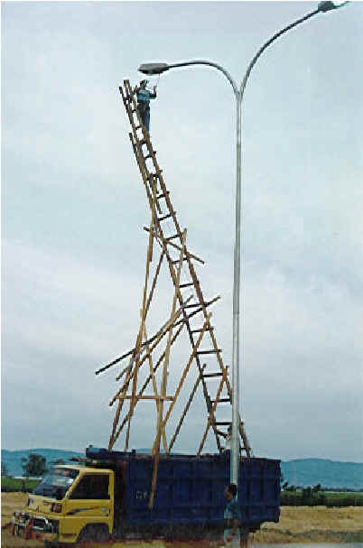

Slide 14
And now the one outside of the competiton...

Slide 15
